Slide 1
Linguistics 200, Week 7
Parts of Speech

Slide 2
Today
What is the lexicon?
What are lexical categories?
In English?
Beyond?

Slide 3
Review - The Lexicon
What’s a lexicon?
What determines what goes into one?
Eskimo ‘snow’
‘phubbing’, ‘ghosting’
‘thundersquall’

Slide 4
Group Activity
What are the parts of speech (lexical categories) of English?
Identify all eight of them, and give at least two examples of each.

Slide 5
Together
What is the function of each of these parts of speech?

Slide 6
Group Activity
Pondering the function of each of these parts of speech, ask yourselves:
Can any of them be collapsed together?
Are any of them not necessary?

Slide 7
Linguistics 200, Week 7
Parts of Speech

Slide 8
Review: Parts of Speech
What is a part of speech (lexical category)?
What are the parts of speech in English?
Which ones can we collapse/combine?

Slide 9
Group Activity
Now jump down the rabbithole that is the internet
Google
ChatGPT
Stack exchange, or whatever!
What sort of variation do we find in parts of speech? How might this help you in crafting your lexicon?

Slide 10
Lexical Categories
What are absolutely required?

Slide 11
Component 3
1. What are the parts of speech in your language? Discuss, using at least three examples of each type. (Be sure to define each word / phrase that you've invented for your language, which you cite)

Slide 12
Pxsinunr
Elijah's Lexicon.docx

Slide 13
Component 3
2. Complete the Swadesh 100 Final List for your language. If your culture lacks a particular word, please replace it with something more culturally/anatomically more appropriate.

Slide 14

Swadesh List?
Morris Swadesh

Slide 15
Example from Mɤɧøɴ
Component 3_ The Mɤɧøɴ Word System.docx

Slide 16
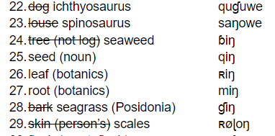
Filling in the Swadesh List
Look through the Swadesh list in your language documents, eliminating any concept that cannot exist in your language and adding those that must exist.

Slide 17
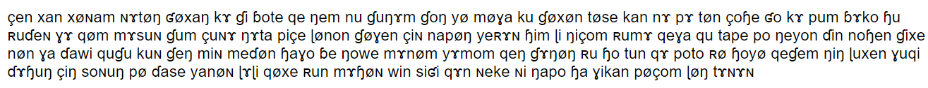
Filling in the Swadesh List
Input your phonotactics into LanguaGen, and generate new word lists.

Slide 18

Filling in the Swadesh List
Pay attention to semantically similar words - perhaps they will also be pronounced in a similar way.

Slide 19
Filling in the Swadesh List
You may want some words to show “onomatopoeia”, but use this sparingly.

Slide 20
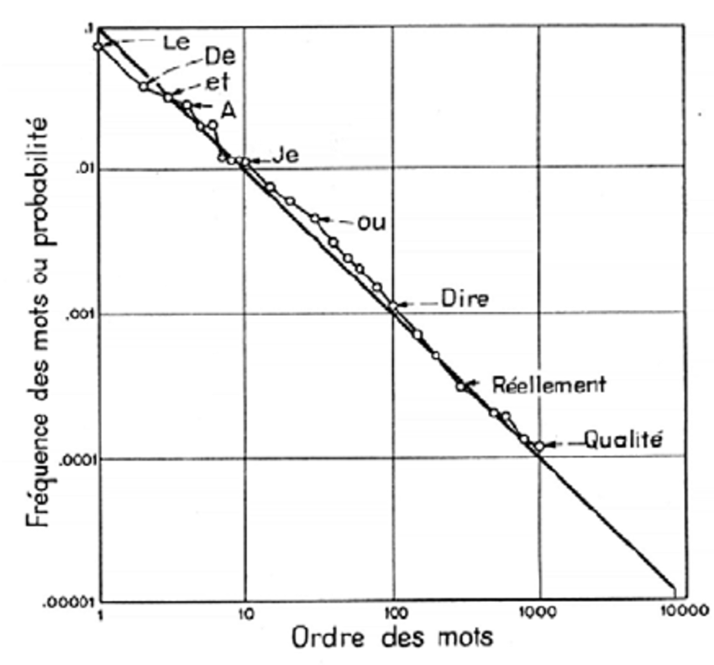
Filling in the Swadesh List
5. Zipf's Law

Slide 21
Pxsinunr
Elijah's Lexicon.docx

Slide 22
Looking Ahead
For Monday: complete your Swadesh List
Identify any words in your Swadesh list that aren't appropriate / necessary, and replace them with ones that are
Generate “words” in LanguaGen
Semantically similar may mean similar sounds
Onomatopoeia
Zipf’s Law

Slide 23
Linguistics 200, Week 7
Parts of Speech

Slide 24
Last Time
Clarification:
What are classifiers?
Proper nouns – Capitalization
What is the name of a group of:
People
Dogs
Cats
Fish
Crows

Slide 25
What would your grammar look like without certain categories?
Merging adjectives and adverbs
That story is true. → ___________________
I speak truly. → ___________________
I am truly happy. → ___________________
I am truly, truly happy. → ___________________
Truly, I am happy. → ___________________

Slide 26
What would your grammar look like without certain categories?
No pronouns
The other day, John went to the store. He saw a giant display for Oreo-flavored Coke, and walked up to it. Right next to it stood his old friend Susie. He greeted her, and then they laughed at it together.

Slide 27
What would your grammar look like without certain categories?
No conjunctions
Me and my friend wanted to go see a movie, because we were super bored. Which should we see: Aliens or Halloween?

Slide 28
What would your grammar look like without certain categories?
No adjectives/modifiers at all
That story is true. → ___________________
I speak truly. → ___________________
I am truly happy. → ___________________
The true story was heard by no one. → ___________________

Slide 29
What would your grammar look like without certain categories?
Only nouns and verbs?
John sleeps.
John teaches Linguistics.
John gives son book.

Slide 30
Today
For Monday: complete your Swadesh List
Identify any words in your Swadesh list that aren't appropriate / necessary, and replace them with ones that are
Generate “words” in LanguaGen
Semantically similar may mean similar sounds
Onomatopoeia
Zipf’s Law

